Slide 1

Classifying Wheat Seed: A Comprehensive Guide
Presenter: Pranav Nandeshwar

Slide 2

Content
1. Understanding the Dataset
2. Model Performance Comparison
3. Predictive Analysis and Conclusion

Slide 3
Project Goal
The goal of this project is to develop a robust and accurate predictive analytics model that classifies wheat seed varieties (Kama, Rosa, and Canadian) based on their physical characteristics.

Slide 4

Section 1
Understanding the Dataset

Slide 5

Exploring Numerical Features
Feature Distribution
Data Visualization
Variety Prediction
Visualizing the distribution of numerical features such as
Area
Perimeter
Compactness
Length
Width
asymmetry coefficient
provides insights into the dataset's characteristics.
Utilizing histograms, pair plots and boxplots to gain a comprehensive understanding of the dataset's numerical attributes and their variations across different varieties.
Using the dataset to predict varieties through machine learning models,
KNeighborsClassifier
GaussianNB
SVC
showcasing the practical application of the analysis.

Slide 6

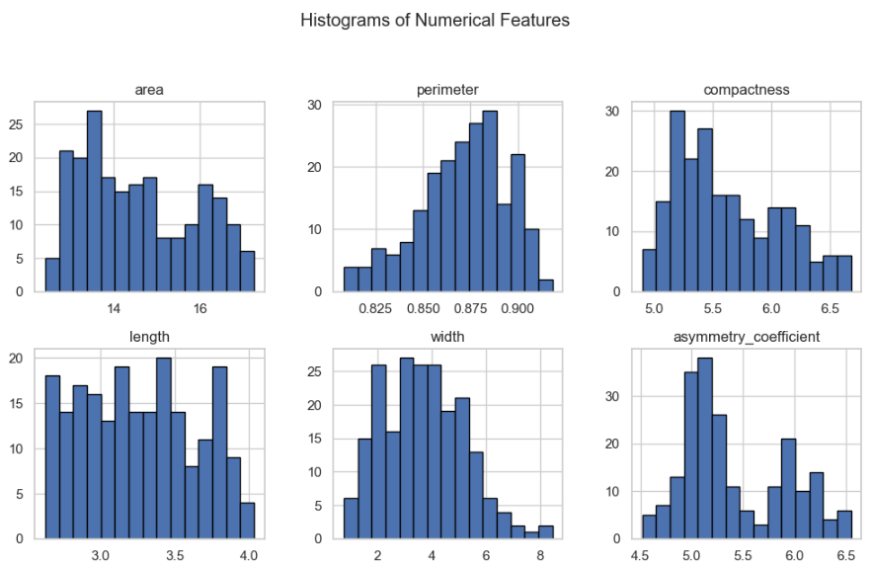
Plot histograms

Slide 7
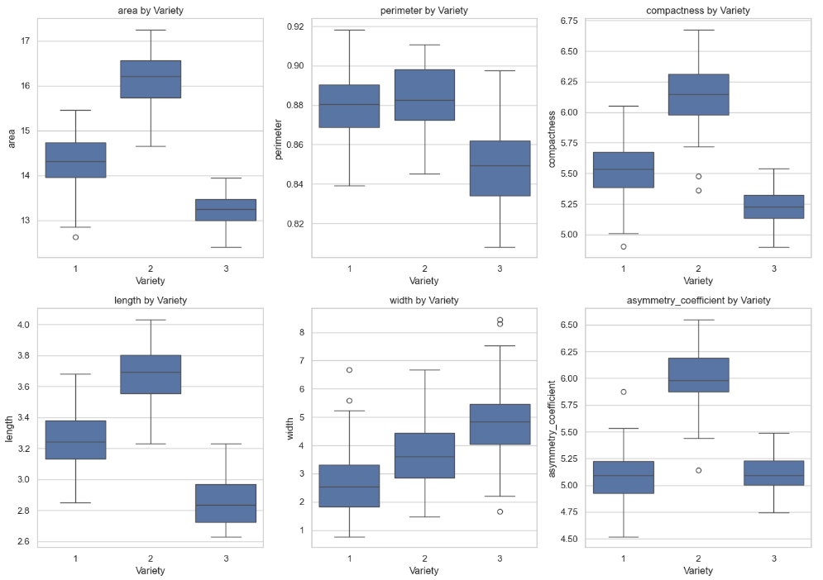
Boxplots for features by Variety

Slide 8
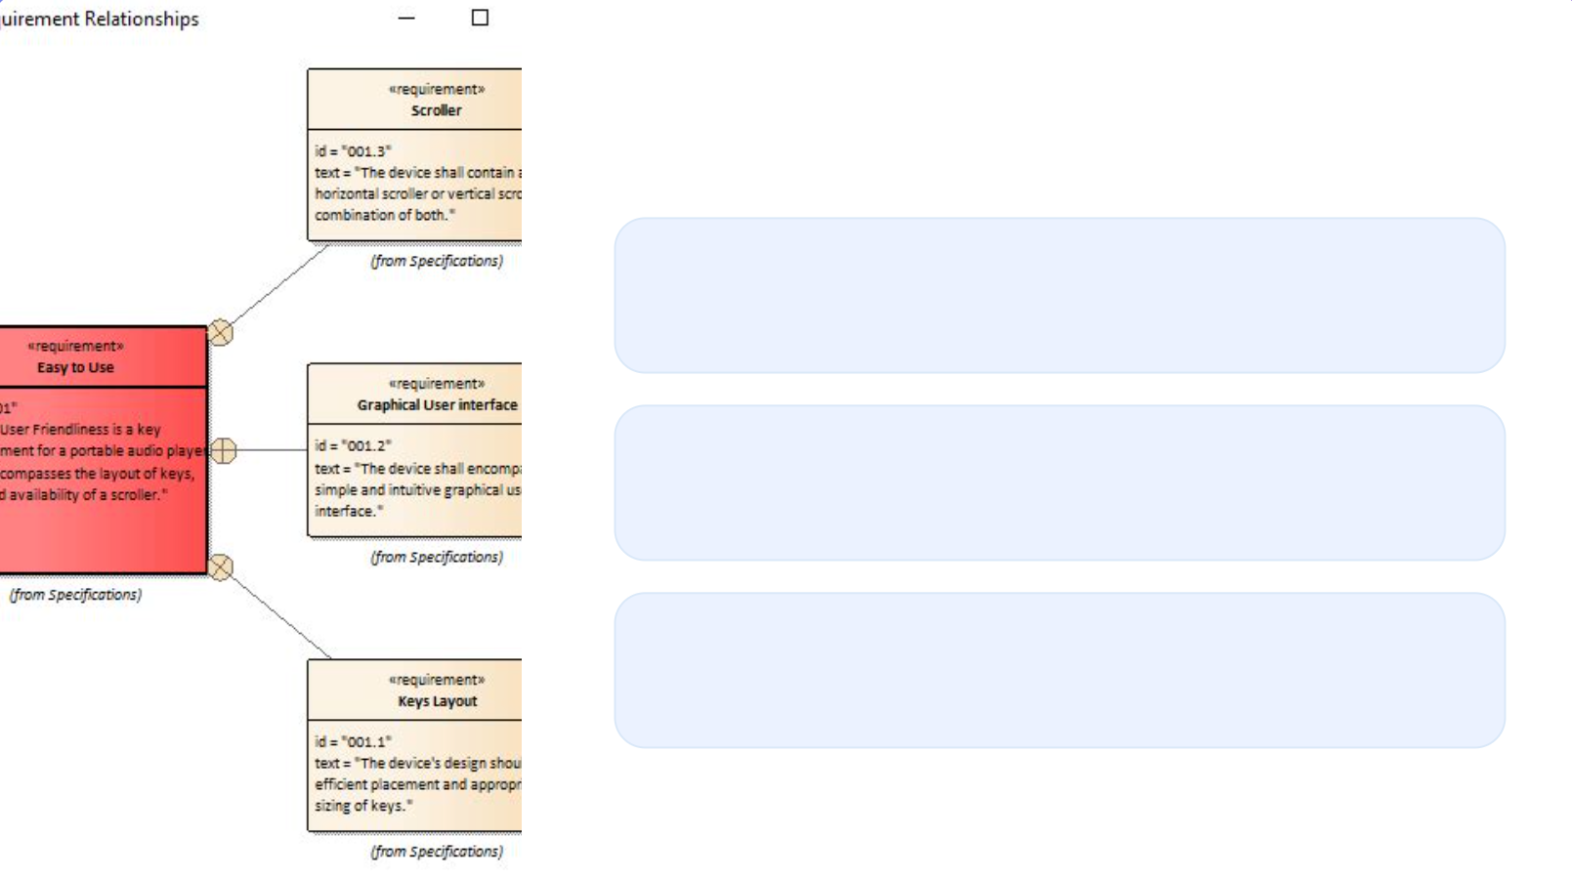
Feature Relationship and Insights
Feature Correlation
Exploring the relationships between different numerical features and their potential impact on predicting varieties using machine learning models.
Insights from Data Analysis
Uncovering key insights from the dataset, including patterns, trends, and potential challenges in predicting varieties based on the available features.
Data Analysis Methods
Highlighting the methods employed to analyze the dataset.

Slide 9

Section 2
Model Performance Comparison

Slide 10

Evaluating Machine Learning Models
01
02
03
Model Accuracy Comparison
Performance Metrics
Challenges and Considerations
Comparing the training accuracies of various machine learning models, such as Gaussian Naive Bayes and Support Vector Machine with a Linear Kernel, to assess their performance in predicting varieties.
Discussing the metrics used to evaluate the performance of machine learning model of KNN and its relevance to the dataset under analysis.
Addressing the challenges -
The outliers
Data distribution w.r.t Variety
Comparing model performance
Suitability of different models for the dataset.

Slide 11
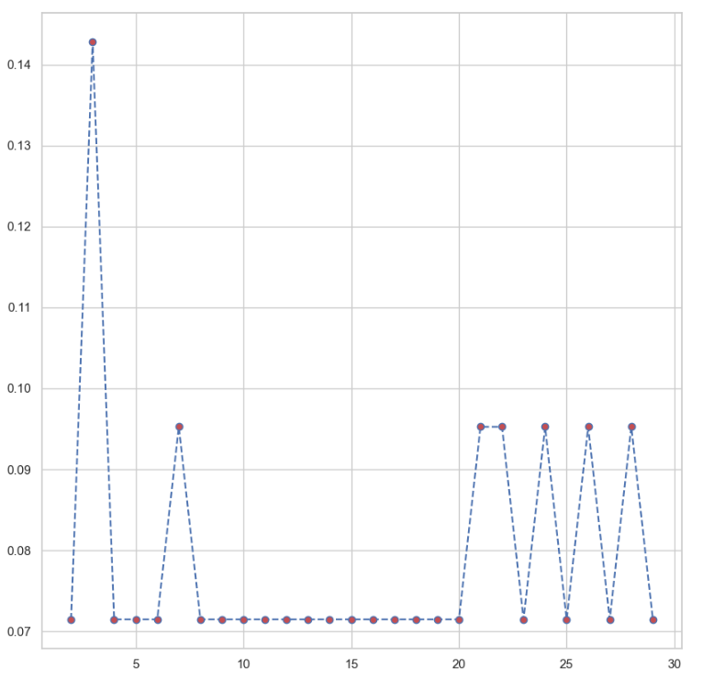
K value vs Error rate

Slide 12
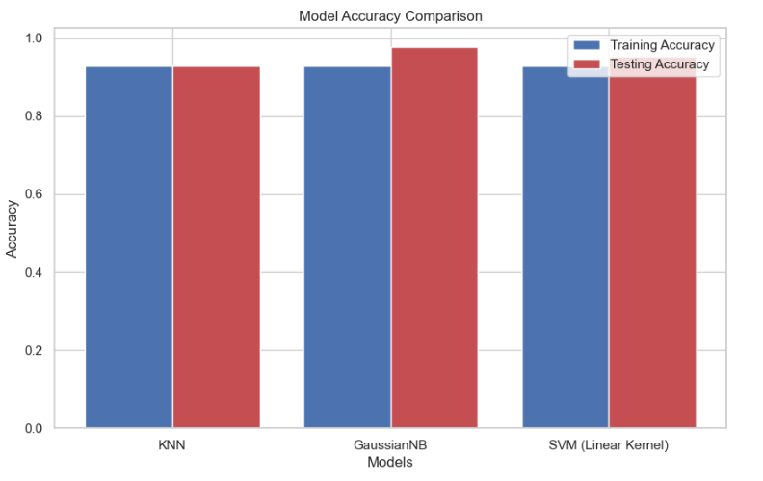
Model Accuracy

Slide 13
Section 3
Predictive Analysis and Conclusion

Slide 14
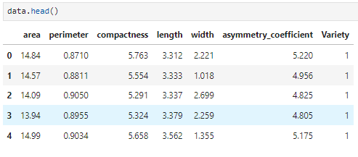
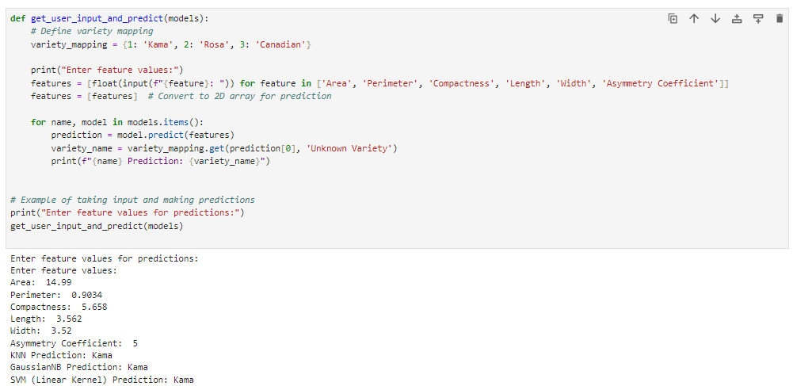
Prediction on Data

Slide 15


Conclusion
Real-World Applications
Future Considerations
Crop Quality Control
Breeding Programs
Supply Chain Optimization
Market Analysis and Pricing
Integration of Advanced Techniques
Incorporation of Multi-Source Data
Real-Time Data Processing
User-Friendly Interfaces and Tools

Slide 16

Thank You
Contact: pranav.nandeshwar@outlook.com

